Slide 1

Cyber Threat Analytics Platform with Incident Visualization System Group 1
Presented By: Nandana N Nair
INFOSYS SPRINGBOARD VIRTUAL INTERNSHIP 7.0
Mentor: Mrs. Nithyasree

Slide 2
FRAMEWORK / 01
PROJECT OBJECTIVES
01
02
Data Collection & Analysis
Threat Monitoring
Collect and analyze cybersecurity incident data from multiple countries and industries to understand the nature and impact of cyber attacks.
Analyze security incidents and identify suspicious activities, emerging threats, and high-risk incidents.
03
04
Trend & Risk Classification
Interactive Dashboards
Study attack trends and classify incidents based on attack type, risk level, and severity.
Develop interactive Power BI dashboards to analyze financial loss, affected users, vulnerabilities, defense mechanisms, and resolution time.

Slide 3
FRAMEWORK / 02
PROJECT DESCRIPTION
The Advanced Threat Incident Analytics and Security Visualization Framework is a Business Intelligence project developed using Microsoft Power BI to analyze global cybersecurity incidents.
M1
M2
M3
Module 1: Problem Understanding
Module 2: Data Collection & Understanding
Module 3: Data Preprocessing
Defined the cybersecurity problem, objectives, and scope of the project.
Collected and explored the Global Cybersecurity Threats (2015–2024) dataset containing approximately 3,000 records.
Cleaned, transformed, standardized, and prepared the dataset using Power Query.
M4
M5
M6
Module 4: Data Modelling
Module 5: Dashboard Development
Module 6: Insights & Interpretation
Created the required data structure, DAX measures, and KPIs for analysis.
Developed interactive dashboards covering attacks, industries, countries, vulnerabilities, defense, severity, financial impact, and patterns.
Analyzed the dashboards to identify meaningful cybersecurity patterns and support data-driven decision-making.

Slide 4
FRAMEWORK / 03
PROJECT WORKFLOW
1. Problem Understanding
2. Data Collection
3. Data Understanding
Identified the cybersecurity problem, project objectives, and required analysis.
Collected the Global Cybersecurity Threats (2015–2024) dataset from Kaggle.
Examined the dataset structure, attributes, data types, and data quality.
↓
↓
↓
6. Data Modelling
5. Data Preprocessing
4. Data Connection
Created the required DAX measures and KPIs for analysis.
↓
Removed duplicates, handled inconsistencies, corrected data types, and standardized the data.
↓
Imported the dataset into Power BI using Power Query.
↓
7. Data Visualization
8. Share / Publish Report
Developed seven interactive Power BI dashboards using different visualizations.
↓
Shared and published the completed Power BI report and dashboards.
↓
↓

Slide 5
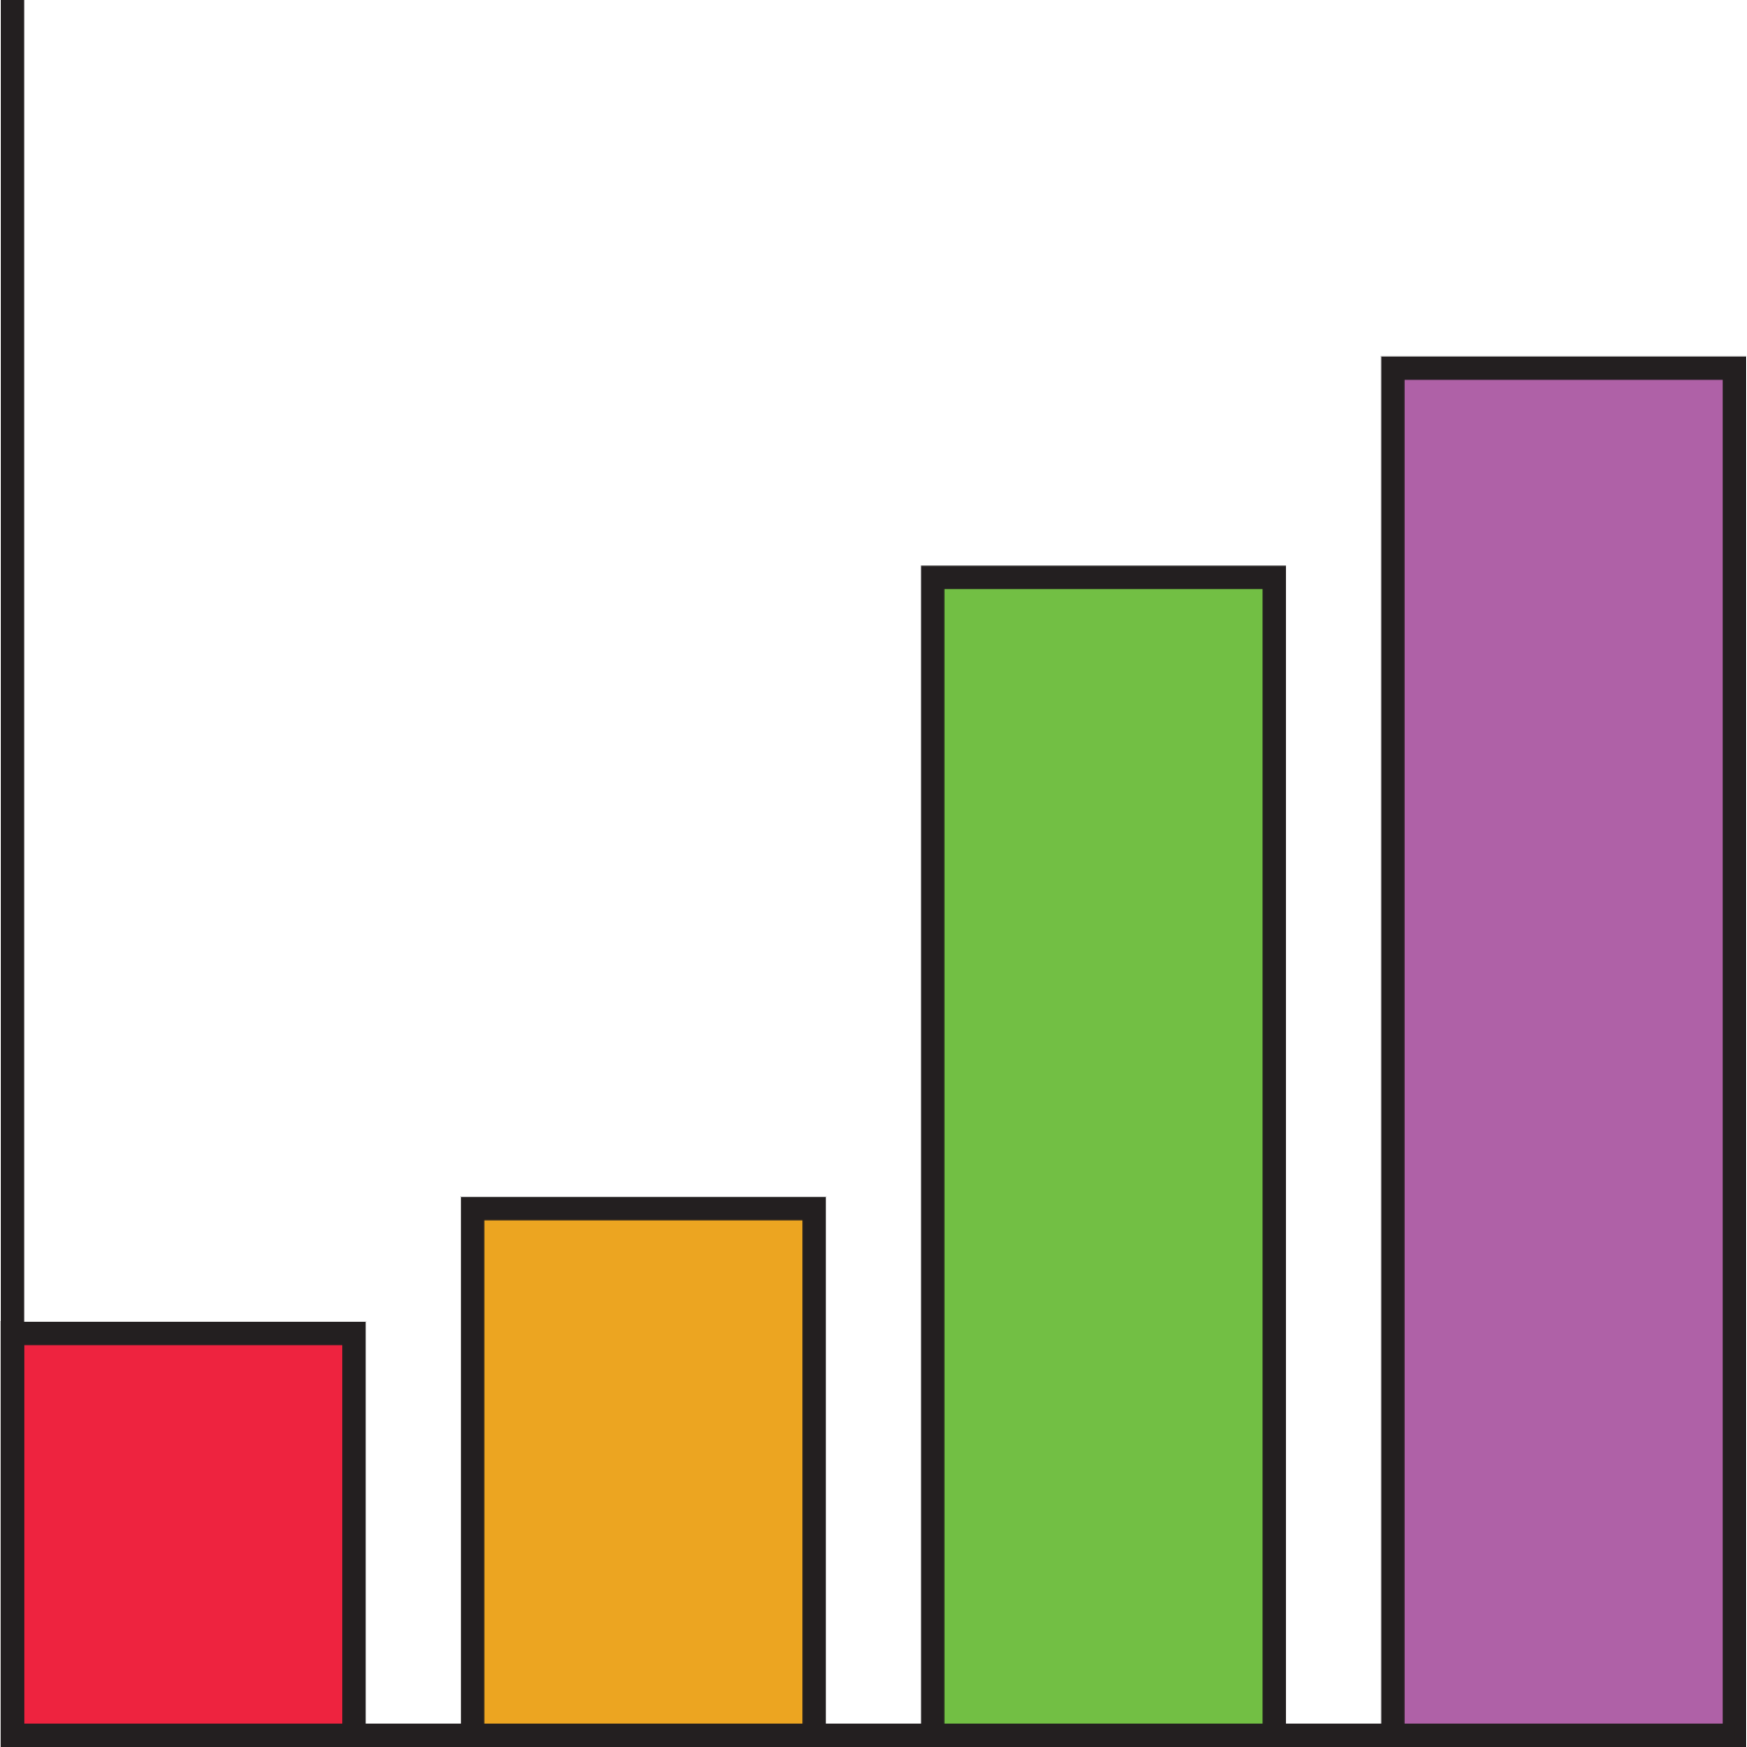
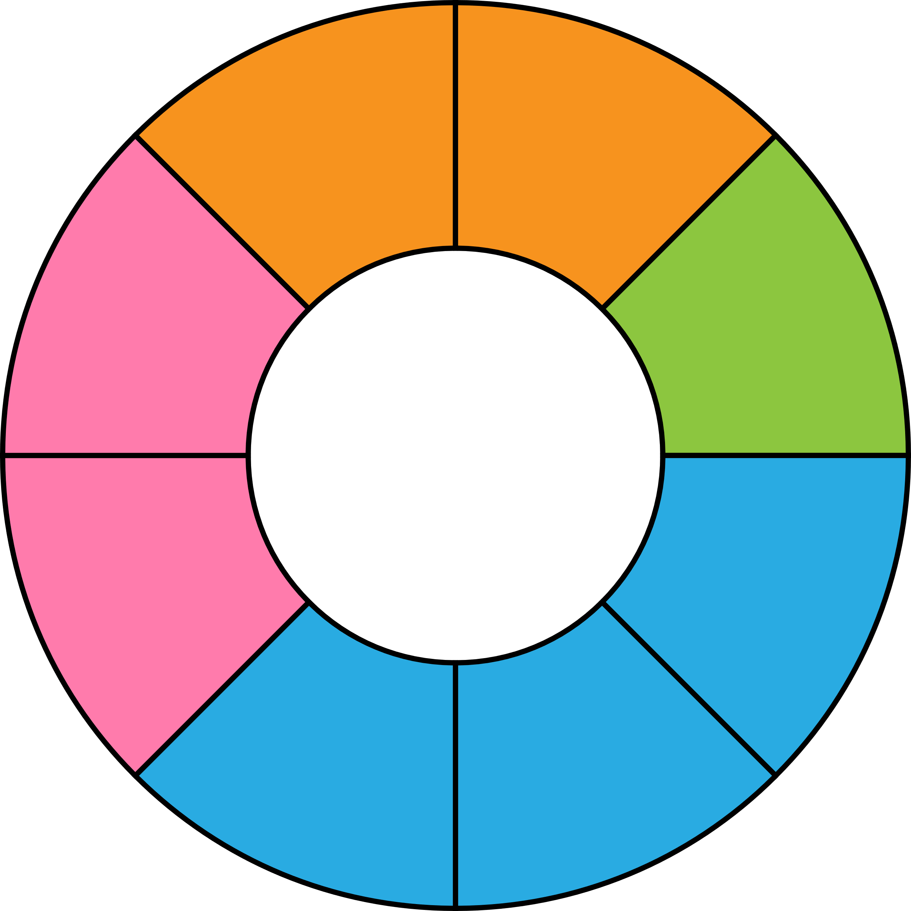
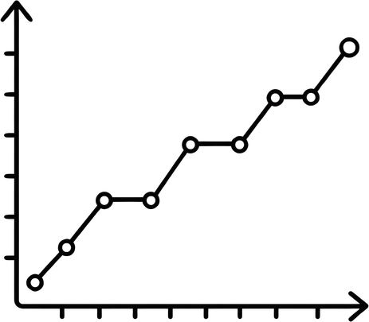
FRAMEWORK / 04
TOP VISUALIZATIONS / COMPONENTS USED
V1
V2
V3
V4
KPI Cards
Bar Charts
Line Charts
Donut Charts
Display important summary measures such as financial loss, affected users, resolution time, and incident counts.
Compare attack types, industries, vulnerabilities, and high-risk incidents.
Show trends in attacks, financial loss, and resolution time over time.
Display the distribution of risk levels and defense mechanisms.
V5
V6
V7
Treemaps
Maps
Slicers
Compare financial loss and incident impact across categories.
Show the geographical distribution of attacks and affected users.
Allow interactive filtering based on year, country, attack source, and risk level.

Slide 6
FRAMEWORK / 05
PROJECT EXECUTION MILESTONES
The Project was executed through four structured milestones to ensure systematic progress and accuracy
Dataset / Source Used
Global Cybersecurity Threats (2015–2024) – Kaggle
01
02
Milestone 1 – Project Planning, Data Collection & Preparation
Milestone 2 – Dashboard Development – Phase 1
Finalized project objectives, collected the cybersecurity dataset, and performed data cleaning and preprocessing using Power Query.
Created DAX measures and KPIs and developed the initial cybersecurity dashboards.
03
04
Milestone 3 – Dashboard Development – Phase 2 & Documentation
Milestone 4 – Advanced Dashboard Development & Final Submission
Developed additional dashboards focusing on industry risk, country analysis, and vulnerabilities and defense.
Developed the Severity & Financial Impact and Pattern Radar dashboards, validated the dashboards, and completed the final project submission.

Slide 7
FRAMEWORK / 06
CHALLENGES FACED AND RESOLUTIONS
1. Data Cleaning & Consistency
Challenge: The raw cybersecurity dataset contained inconsistencies that needed to be addressed before analysis.
Resolution: Used Power Query to clean the data, remove duplicates, correct data types, and standardize values.
2. Selecting Relevant Visualizations
Challenge: Choosing suitable visualizations for different cybersecurity metrics while keeping the dashboards clear.
Resolution: Selected visual types according to the purpose of each analysis, such as bar charts for comparisons, line charts for trends, maps for geographical analysis, and KPI cards for summary values.
3. Dashboard Design & Interactivity
Challenge: Presenting a large amount of information while keeping dashboards clear and interactive.
Resolution: Organized the analysis across multiple dashboards and used slicers, filters, and appropriate visual layouts to improve usability.

Slide 8
FRAMEWORK / 07
LEARNINGS & SKILLS ACQUIRED
Technical Skills
Soft Skills
Microsoft Power BI
Power Query
Data Cleaning & Transformation
DAX Measures & KPIs
Interactive Dashboard Development
Data Visualization & Analysis
Analytical Thinking
Problem-Solving
Team Collaboration
Communication Skills
Presentation Skills
Time Management
Overall Learning
Gained practical experience in transforming raw cybersecurity data into meaningful visual insights and applying data analytics concepts to an industry-oriented project.

Slide 9
FRAMEWORK / 08
FUTURE ENHANCEMENTS
Future Enhancements
Key Insights
Integrate real-time cybersecurity threat data instead of static datasets.
Implement machine learning techniques for threat prediction and anomaly detection.
Add automated alerts and AI-based risk prediction.
Publish dashboards through Power BI Service with scheduled data refresh.
Cybersecurity risks vary across industries and countries.
Financial loss, affected users, and attack patterns provide important indicators of incident impact.
Interactive visualization makes complex cybersecurity information easier to analyze and understand.

Slide 10

FRAMEWORK / 09
CONCLUSION
Cyber Threat Analytics Platform with Incident Visualization System successfully transforms raw cybersecurity data into seven interactive Power BI dashboards.
The project provided practical experience in data cleaning, Power Query, data modelling, DAX, data visualization, and dashboard development.
The dashboards helped analyze cyber attacks, risk levels, vulnerabilities, defense mechanisms, financial losses, affected users, and resolution time.
Overall, the project demonstrates how Business Intelligence and data visualization can transform cybersecurity data into meaningful insights and support better security monitoring and decision-making.

Slide 11
FRAMEWORK / 10
ACKNOWLEDGEMENTS AND REFERENCES
Acknowledgements
References
I would like to express my sincere gratitude to:
Infosys Springboard Team
For providing the opportunity to participate in the Virtual Internship 7.0.
Mentor – Mrs. Nithyasree
For providing valuable guidance, feedback, and encouragement throughout the project.
Team Members
Himanshu Kumar Soni
Janani G K
Kantamreddy Narayani
K Kotnala Bindu
Nagalla Gohitha Meghana
Kaggle & Power BI Community
For providing useful resources, dataset access, and documentation that supported the project.
Kaggle – Global Cybersecurity Threats (2015–2024) Dataset
Microsoft Power BI Documentation & Community Resources
Infosys Springboard – Virtual Internship 7.0 Program Materials

Slide 12
Cyber Threat Analytics Platform with Incident Visualization System Group 1
Thank You

